Slide 1

CISC360 Computer Architecture
Lesson 7
Instruction Sets

Slide 2

What is an instruction set?
The complete collection of instructions that are understood by a CPU
Machine Code
Binary
Usually represented by assembly codes for human consumption
Notes:
2

Slide 3
Elements of an Instruction
Operation code (Op code)
  Do this
Source Operand reference
  To this
Result Operand reference
  Put the answer here
Next Instruction Reference
  When you have done that, do this...
Notes:
3

Slide 4
Where have all the Operands gone?
Long time passing….
(If you don’t understand, you’re too young!)
Main memory (or virtual memory or cache)
CPU register
I/O device
Notes:
4

Slide 5
Instruction Representation
In machine code each instruction has a unique bit pattern
For human consumption (well, programmers anyway) a symbolic representation is used
  e.g. ADD, SUB, LOAD
Operands can also be represented in this way
  ADD A,B
Notes:
5

Slide 6
Instruction Types
Data processing
Data storage (main memory)
Data movement (I/O)
Program flow control
Notes:
6

Slide 7
Number of Addresses (a)
3 addresses
  Operand 1, Operand 2, Result
  a = b + c;
  May be a forth - next instruction (usually implicit)
  Not common
  Needs very long words to hold everything
Notes:
7

Slide 8
Number of Addresses (b)
2 addresses
  One address doubles as operand and result
  a = a + b
  Reduces length of instruction
  Requires some extra work
    Temporary storage to hold some results
Notes:
8

Slide 9
Number of Addresses (c)
1 address
  Implicit second address
  Usually a register (accumulator)
  Common on early machines
Notes:
9

Slide 10
Number of Addresses (d)
0 (zero) addresses
  All addresses implicit
  Uses a stack
  e.g. push a
  push b
  add
  pop c
  c = a + b
Notes:
10

Slide 11
How Many Addresses
More addresses
  More complex (powerful?) instructions
  More registers
    Inter-register operations are quicker
  Fewer instructions per program
Fewer addresses
  Less complex (powerful?) instructions
  More instructions per program
  Faster fetch/execution of instructions
Notes:
11

Slide 12
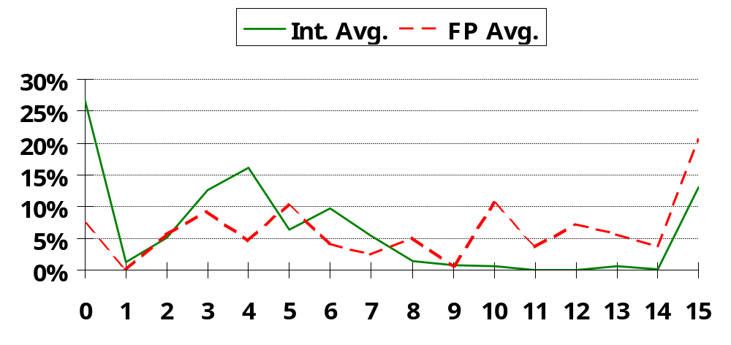
Displacement Address Size?
Address Bits
°
Avg. of 5 SPECint92 programs v. avg. 5 SPECfp92 programs
°
3
4
X-axis is in powers of 2: 4 => addresses > 2
(8) and Š 2
(16)
°
1% of addresses > 16-bits
°
12 - 16 bits of displacement needed

Slide 13
Design Decisions (1)
Operation repertoire
  How many ops?
  What can they do?
  How complex are they?
Data types
Instruction formats
  Length of op code field
  Number of addresses
Notes:
12

Slide 14
Design Decisions (2)
Registers
  Number of CPU registers available
  Which operations can be performed on which registers?
Addressing modes (later…)
RISC v CISC
Notes:
13

Slide 15
Types of Operand
Addresses
Numbers
  Integer/floating point
Characters
  ASCII etc.
Logical Data
  Bits or flags
(Aside: Is there any difference between numbers and characters? Ask a C programmer!)
Notes:
14

Slide 16
Pentium Data Types
8 bit Byte
16 bit word
32 bit double word
64 bit quad word
Addressing is by 8 bit unit
A 32 bit double word is read at addresses divisible by 4
Notes:
15

Slide 17
Specific Data Types
General - arbitrary binary contents
Integer - single binary value
Ordinal - unsigned integer
Unpacked BCD - One digit per byte
Packed BCD - 2 BCD digits per byte
Near Pointer - 32 bit offset within segment
Bit field
Byte String
Floating Point
How do we prevent “bad things™”
from happening when performing
operations with dissimilar data types?
Notes:
16

Slide 18
Types of Operation
Data Transfer
Arithmetic
Logical
Conversion
I/O
System Control
Transfer of Control
Notes:
18

Slide 19
Data Transfer
Specify
  Source
  Destination
  Amount of data (how much do we allow?)
May be different instructions for different movements
  e.g. IBM 370
Or one instruction and different addresses
  e.g. VAX
Notes:
19

Slide 20
Arithmetic
Add, Subtract, Multiply, Divide
Signed Integer
Floating point ?
May include
  Increment (a++)
  Decrement (a--)
  Negate (-a)
Notes:
20

Slide 21
Logical
Bitwise operations
AND, OR, NOT
Notes:
21

Slide 22
Conversion
E.g. Binary to Decimal
EBCDIC to ASCII
Single-precision to double-precision
Decimal to packed decimal
Notes:
22

Slide 23
Input/Output
May be specific instructions
May be done using data movement instructions (memory mapped)
May be done by a separate controller (DMA)
Notes:
23

Slide 24
Systems Control
Privileged instructions
CPU needs to be in specific state
  Ring 0 on 80386+
  Kernel mode
For operating systems use
Notes:
24

Slide 25
Transfer of Control
Branch
  e.g. branch to x if result is zero
Skip
  e.g. increment and skip if zero
  ISZ Register1
  Branch xxxx
  ADD A
Subroutine call
  c.f. interrupt call
Notes:
25

Slide 26
Byte Order
(A portion of chips?)
What order do we read numbers that occupy more than one byte
e.g. (numbers in hex to make it easy to read)
12345678 can be stored in 4x8bit locations as follows
Notes:
27

Slide 27
Byte Order (example)
Address Value (1) Value(2)
184 12 78
185 34 56
186 56 34
186 78 12
i.e. read top down or bottom up?
Notes:
28

Slide 28
Byte Order Names
The problem is called Endian
The system on the left has the least significant byte in the lowest address
This is called big-endian
The system on the right has the least significant byte in the highest address
This is called little-endian
Notes:
29

Slide 29
Standard…What Standard?
Pentium (80x86), VAX are little-endian
IBM 370, Motorola 680x0 (old Macintoshes, network devices), and most RISC are big-endian
Internet is big-endian
  Makes writing Internet programs on PC more awkward!
  WinSock provides htoi and itoh (Host to Internet & Internet to Host) functions to convert
Notes:
30

Slide 30
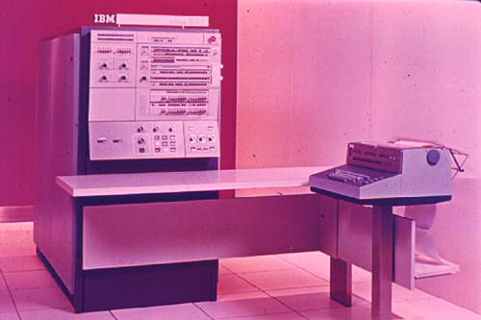
Some Interesting Systems
IBM System/360

Slide 31
IBM System/360 Family
Why study old mainframes?
  Long-lived, commercially viable for over 30 years (1965 first delivery)
  Compatible family w/large performance range
  Eight-bit byte
  Address size expansion over time (24-31 bit)
  Virtual memory
  Standard interfaces at several layers of abstraction

Slide 32
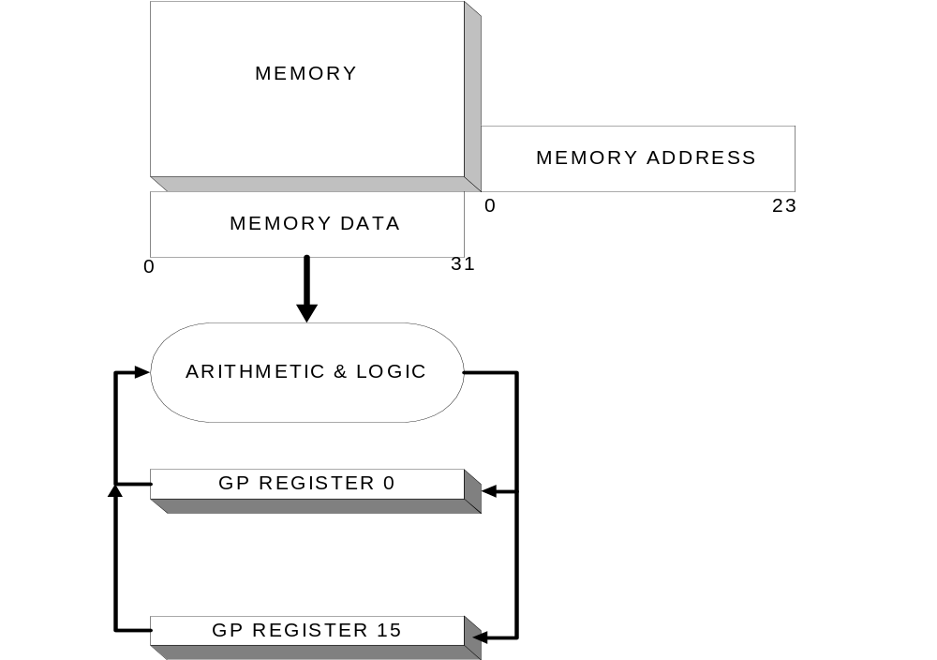
Basic Memory Model - S/360

Slide 33
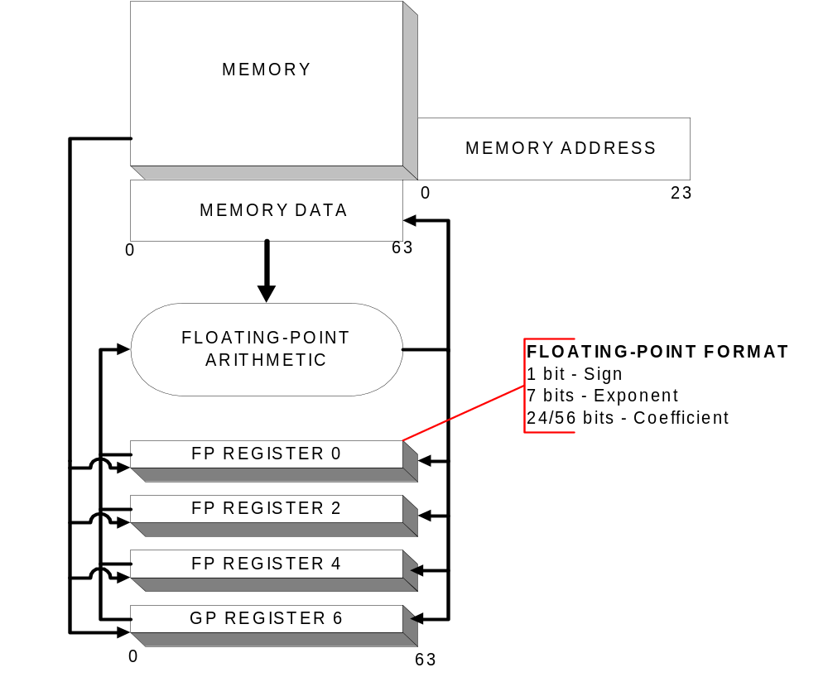
Floating Point Model

Slide 34
Special Data Types
Characters - 8-bit byte, EBCDIC (primary), ASCII
Decimal Arithmetic
Fixed-point Numeric (16-,32-bit)
Floating-point Numeric (32-,64-bit originally, 128-bit Extended Precision later)

Slide 35
Instruction Types
8-bit Operation Code
16-,32- and 48-bit Instruction Length
Multiple addressing modes

Slide 36
Instruction Formats
Opcode
R1 R2
RR Format
AR R1,R2
Opcode
R1 X2
D2
B2
RX Format
A 5,CAB(8)
Opcode
R1 R3
D2
B2
RS Format
ICM R1,M3,D2(B2)

Slide 37
Instruction Formats
Opcode
Imm
D1
B1
SI Format
CLI D1(B1),Imm
Opcode
L1 L2
D1
D2
B1
B2
SS Format
CP D1(L1,B1),D2(L2,B2)
Opcode
L0
D1
D2
B1
B2
SS Format
MVN D1(L,B1),D2(B2)

Slide 38
Address Mapping
Address mapping added later (virtual memory on 360/67)
Address modification
  Base, displacement
  Base, index, displacement
  No special index registers

Slide 39
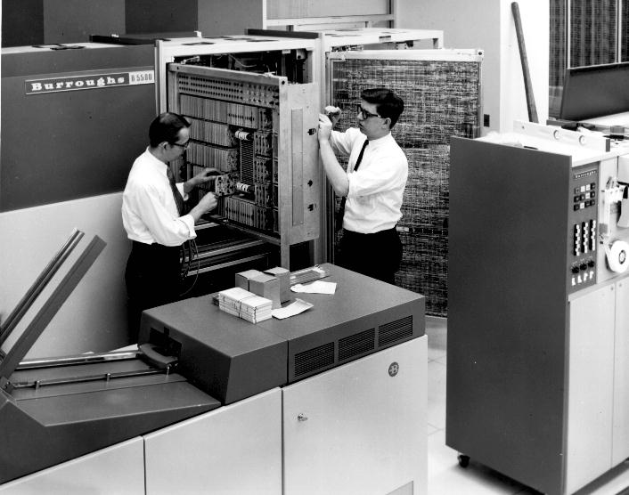
Some Interesting Systems
Burroughs B-xx00 – Stack-oriented Systems

Slide 40
Burroughs Family
Burroughs B5000 - limited availability (1963)
  field upgraded to B5500
Burroughs B5500 - moderately successful
  early adopter of stack architecture, multiprocessing, virtual memory
  extensive use of high-level languages for systems programming (ESPOL, DC-ALGOL)
  UDel’s first timesharing system!

Slide 41
Burroughs Family
1963
1970
B5000
B5500
B5700
B6500
B6700
B7700
1968
1971
1973
Unisys
A-series
(current)

Slide 42
High Level Language Support
Derived from ALGOL 60 specification
All programs were re-entrant
Powerful subroutine and parameter-passing support
Master Control Program written in ESPOL
Time-sharing system in DC-ALGOL

Slide 43
Other Oddities
Data objects are characterized by descriptors
  Data location
  Index range (automatic protection!)
  Presence in physical memory
  Type of data (character, floating point, etc.)
Stack
  Most opcodes operated on stack (0 address instructions)

Slide 44
Oddities
48-bit word, 6-bit bytes (dual mode)
12-bit instruction (syllables), 10-bit address field
NO integer arithmetic mode
Dual processor systems

Slide 45
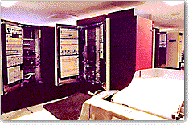
Some Interesting Systems
GE/MIT MULTICS System

Slide 46
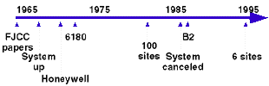
Why Multics is Important
Early multi-user system
Sophisticated memory protection system
Second O/S written in a HLL
A lot of Unix came from Multics
Early industry/academic joint venture
Fist system to get NCSC B2 rating

Slide 47
Goals of Multics
Convenient remote terminal use.
Continuous operation analogous to power & telephone services.
A wide range of system configurations, changeable without system or user program reorganization.
A high reliability internal file system.
Support for selective information sharing.
Hierarchical structures of information for system administration and decentralization of user activities.
Support for a wide range of applications.
Support for multiple programming environments & human interfaces.
The ability to evolve the system with changes in technology and in user aspirations

Slide 48
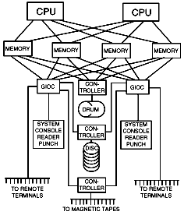
GE-645 System Diagram
Duplex CPU (.435 MIPS)
Multiple banks of memory
Virtual memory
Dual ports on storage (256KWords/box, 1 usec access time ferrite core)
DYNAMIC RECONFIGURATION!
36-bit word
Drum – 4 megaword cap., 16 msec access time (“Firehose”)

Slide 49
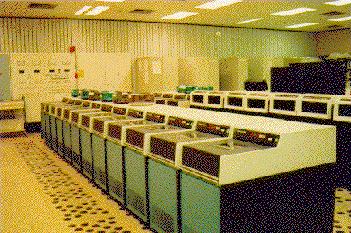
System Configurations (GE645)
Up to 8 CPU's
Up to 16 million words of core
Up to 2 high speed drums
Up to 300 million words of disc
Up to 32 tapes
Up to 8 card readers and punches
16 printers
And up to 1000 or more typewriter consoles!

Slide 50
Multics Virtual Memory
Three levels
  Ferrite core
  Drum
  Disk
256KW segment size (2¹⁸ words/segment, 2¹⁸ segments/user)
Paged memory
All CPUs share the common memory address space
Disk files are addressed same as RAM!

Slide 51
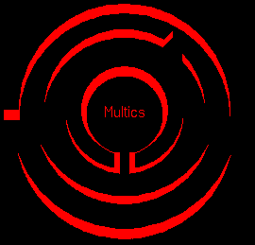
GE-645 System/Memory Protection
Ring 0 – Kernel
1 – “Supervisor extensions”
2,3 – DBMS, TCP/IP
4 – User programs
5 – Less-priv. Users
6,7 – rarely used
Permissions - Read, write, execute

